Slide 1
Adaptive Thresholding
By
Abhinaba Chowdhury
Abhiroop Mukherjee
Debarghya Dey
Jyotiprakash Roy
Shrutanten

Slide 2
What is adaptive thresholding?
Compared to simple thresholding (done previously) where the threshold value is global, i.e., it is same for all the pixels in the image, adaptive thresholding is the method where the threshold value is calculated for smaller regions and therefore, there will be different threshold values for different regions.

Slide 3
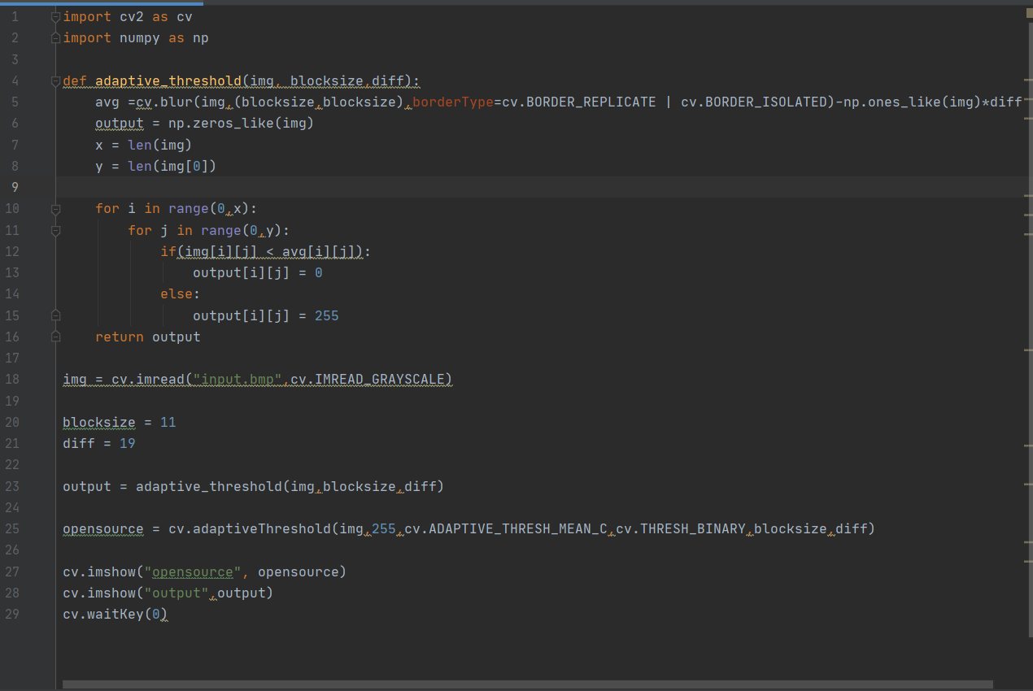
Python code for implementing adaptive thresholding :

Slide 4
Pseudo code :
input blocksize (n) , subtracting value (c)
for every n*n block in image:
calculate mean of values of the block(m)
threshold = mean - c
binarise the block using threshold
save new image

Slide 5


Outputs (Image 1) :
Original Image
Image produced by the algorithm

Slide 6
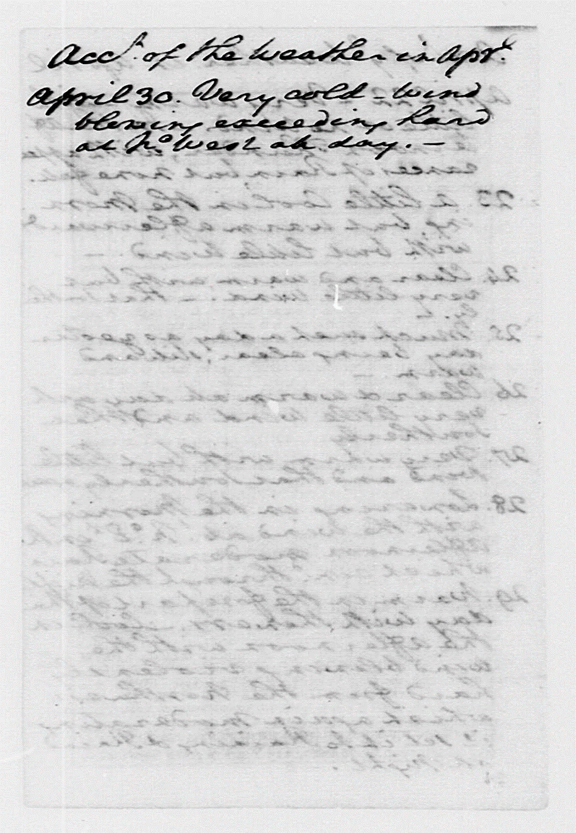

Outputs (Image 2) :
Original Image
Image produced by the algorithm

Slide 7

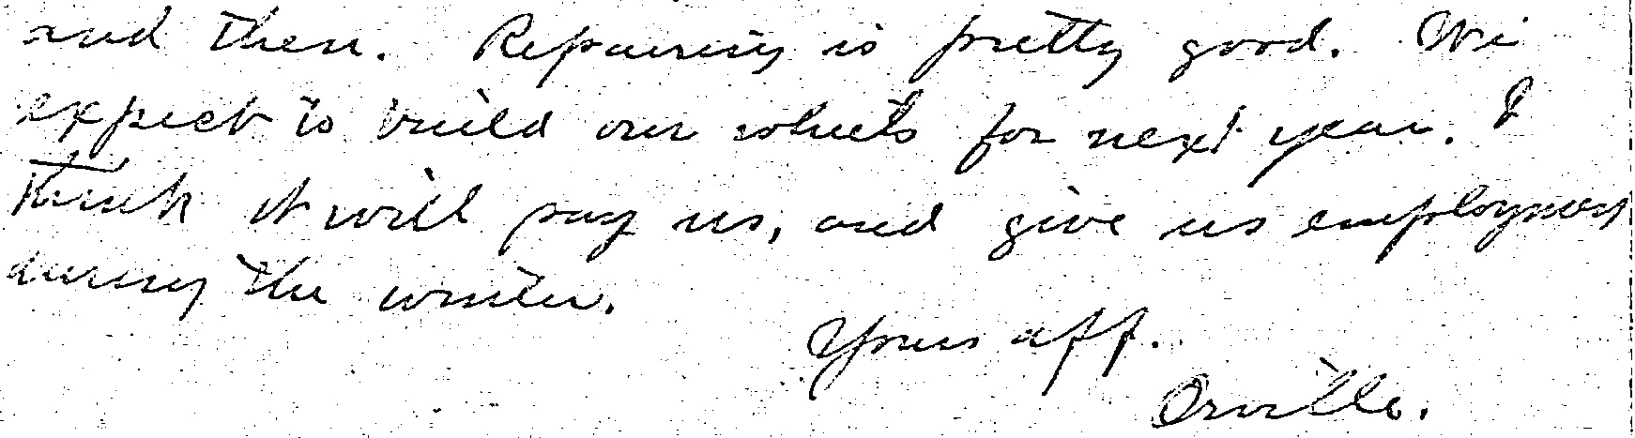
Outputs (Image 3) :
Original Image
Image produced by the algorithm

Slide 8

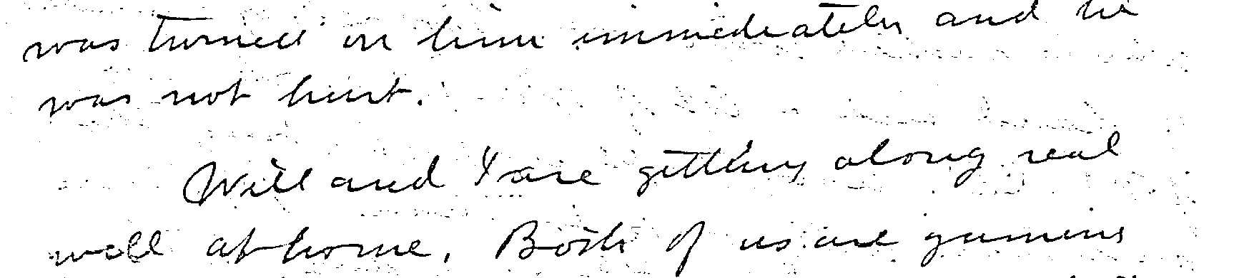
Outputs (Image 4) :
Original Image
Image produced by the algorithm

Slide 9

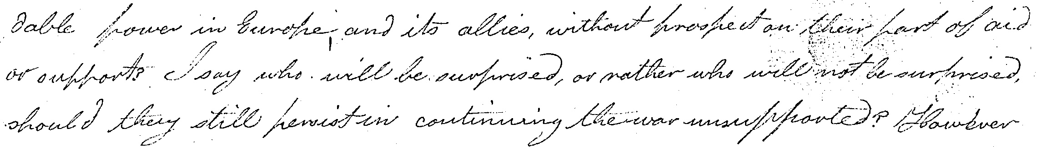
Outputs (Image 5) :
Original Image
Image produced by the algorithm

Slide 10

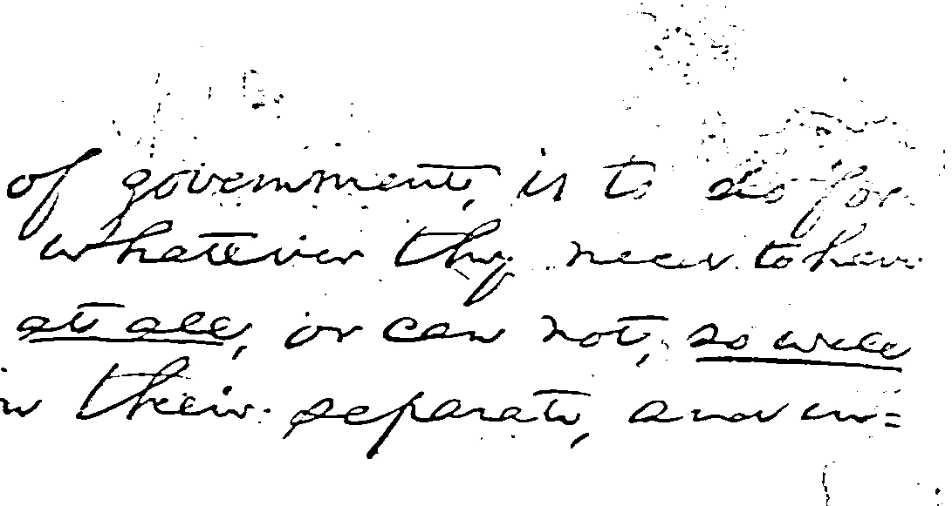
Outputs (Image 6) :
Original Image
Image produced by the algorithm

Slide 11

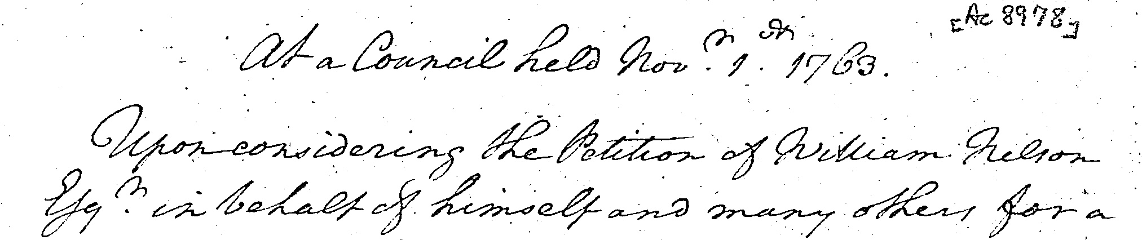
Outputs (Image 7) :
Original Image
Image produced by the algorithm

Slide 12
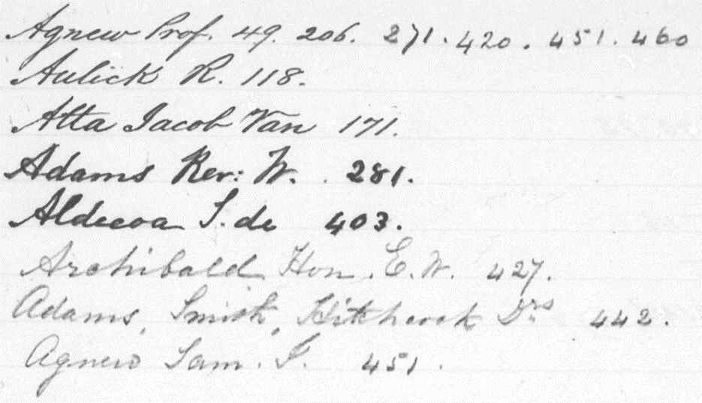
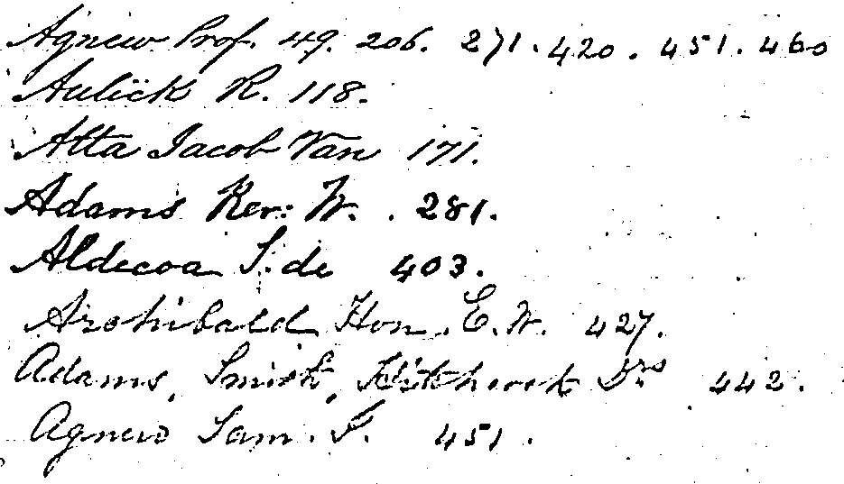
Outputs (Image 8) :
Original Image
Image produced by the algorithm

Slide 13
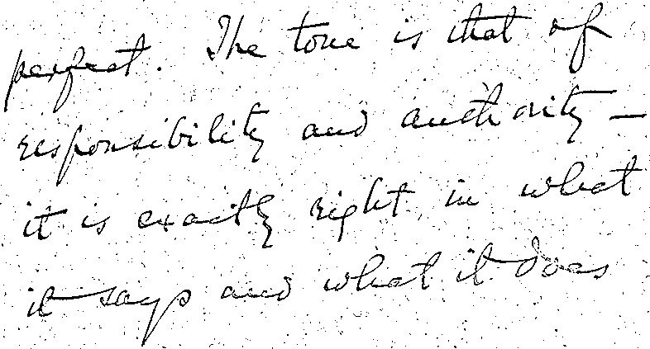
Outputs (Image 9) :
Original Image
Image produced by the algorithm

Slide 14

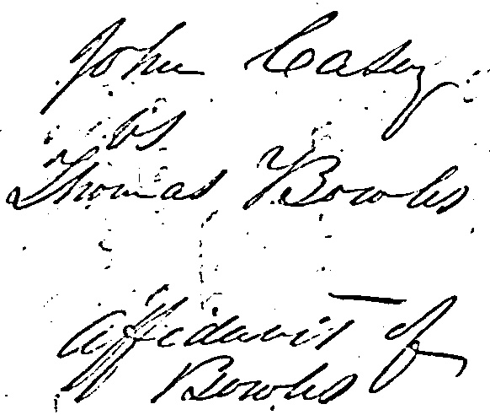
Outputs (Image 10) :
Original Image
Image produced by the algorithm

